Slide 1



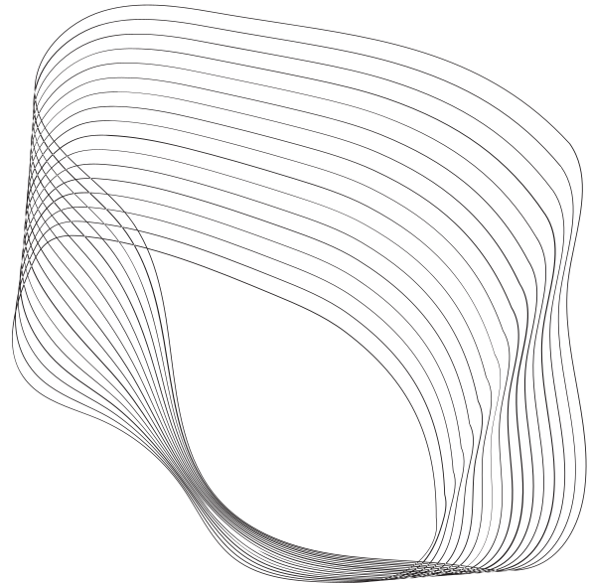
Green University
CSE-310 SECTION: D-07
DATA COMMUNICATION Lab
Presented By
Presented To
Md.Saidul Islam Shuvo
ID:221902104
Muhaimen Khan
Lecturer of Dept of CSE

Slide 2


CONTENT
01
INTRODUCTION
02
GOAL & OBJECTIVES
03
USED TECHNOLOGY
04
LIMITATIONS
05
FUTURE WORK
06
CONCLUSION

Slide 3



01
LINE CODING VISUALIZATION

Slide 4


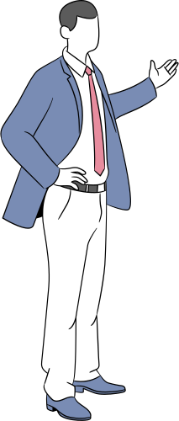





GOAL & OBJECTIVE’S
02
Skill Development
Academic Achievement
User Experience
Personal Growth

Slide 5

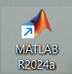

USED TECHNOLOGY
USED TECHNOLOGY
03
RESPONSIVE DESIGN

Slide 6

05
LIMITATIONS
LIMITATIONS
Advance Techniques
Accessible only to MATLAB users

Slide 7


06
FUTURE WORK
Advance Modulation
Animation
ERROR Simulation
09

Slide 8
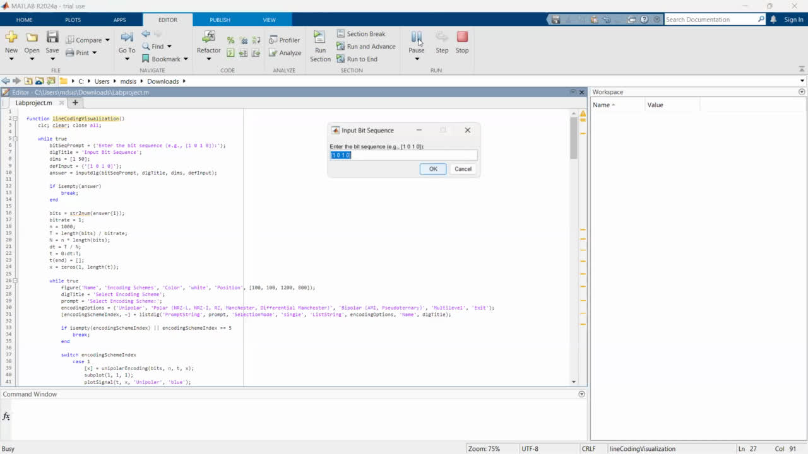

Video
USED TECHNOLOGY
03

Slide 9

07
Any Question?

Slide 10

08

